Slide 1


Introduction to Git and GitHub
Noel McGrath

Slide 2
White board and marker
Email billy to mary
Me to email mary on room, numbers, audience, and my agenda.
Slide on resources, presentations etc
Slide on what not covered
Gitk & git gui
Git integration
What will not cover
TODO – install git
Gitignore and gitattributes files

Slide 3
Agenda
Getting to know Git
Working with Git locally
Working with Git remotely
Branching and Merging
Git integration
GitHub
GitHub for Windows

Slide 4
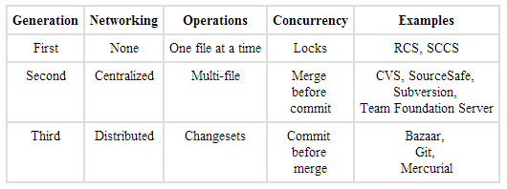
History of Version Control Systems
http://www.ericsink.com/vcbe/html/history_of_version_control.html

Slide 5
Distributed Version Control Systems (DVCS for short)
Full history on local repository
You commit changes to your own repository
The owner of the official repository can pull those changes
Can have a centralised repository that all contributors can push to
Branching/merging reliable and easy
Backups are easy – each clone is a full backup
Deployments - heroku

Slide 6
Git
Created by Linus Torvalds for Linux kernel development in 2005
Linux fell out with BitKeeper
Free and open source
Runs on many OS’s
Handle small to very large projects
Fast performance
Cheap local branching
Simplicity

Slide 7
Installation On Windows
http://msysgit.github.io/
Configure Git
Levels
System
User
Repository

Slide 8
Command Line or GUI?
GUI and IDE options
Git Gui
TortoiseGit
Git Extensions
SourceTree
Visual Studio Tools for Git
GitHub on Windows
Egit – Eclipse
Many more …..

Slide 9
Our First Repository
Creating a repository
Adding files and committing
Making changes and diffs
Viewing history
Refactoring and viewing diffs
Ignoring files using .gitignore
Demo

Slide 10
Working With Remote Repository
Cloning
Listing repositories
Fetching and Merging
Pulling
Pushing changes
Tags

Slide 11
Why Use Version Control?
Lecturers
Students
Used in the industry
Software evolution
Track individual and group projects
Preparing for work
Sharing and collaboration
Workflow
Rollbacks

Slide 12
Temp
Lecturers
Students
Used in the industry
Software evolution
Track individual and group projects
Preparing for work
Sharing and collaboration
Workflow
Rollbacks

